Slide 1
A Practical Wrapper Protocol for Metadata-Hiding in Messaging
Lea Thiemt
FAU Erlangen-Nürnberg
Paul Rösler
FAU Erlangen-Nürnberg
Alexander Bienstock
J.P. Morgan AI Research and J.P.
Morgan AlgoCRYPT CoE
Rolfe Schmidt
Signal Messenger
Yevgeniy Dodis
New York University

Slide 2




Online Messaging
Server
TransportHeader:
src,dst…
TransportHeader:
src,dst…
TransportHeader:
src,dst…
Header:
Seq.Num
ID...
Header:
Seq.Num
ID...
Header:
Seq.Num
ID...
Header:
Seq.Num
ID...
Header:
Seq.Num
ID...
Header:
Seq.Num
ID...
Hi, Blake!
Enc
5f8ac9134d
5f8ac9134d
5f8ac9134d
Dec
Hi, Blake!
TLS
TLS
Notes:
Server doesn’t have key, cannot read content
But can: collect metadata – e.g., when ciphertext arrives, who sender/receiver, how frequent comm
Can already reveal personal information about the users or even about the context which users might want to keep private → hide metadata
Can be information that routing protocol needs (where to forward the ciphertext to)
We look at metadata on c level

Slide 3



Online Messaging
Server
TransportHeader:
src,dst…
TransportHeader:
src,dst…
TransportHeader:
src,dst…
Header:
Seq.Num
ID...
Header:
Seq.Num
ID...
Header:
Seq.Num
ID...
Header:
Seq.Num
ID...
Header:
Seq.Num
ID...
Header:
Seq.Num
ID...
Hi, Blake!
Enc
5f8ac9134d
5f8ac9134d
5f8ac9134d
Dec
Hi, Blake!
TLS
TLS
Goal: Hide Metadata on Ciphertext-Layer
...
Notes:
There is metadata here already
Illustrate: Only c (no metadata) anonymously from Alex to Blakes messenger
Thing: Blake has many contacts and with each of these contacts shares a different key
If there is no context for the ciphertext, B doesn’t know which key to use for decryption
That’s why metadata
Only by seeing this, the server can already infer information about the senders communication patterns
That’s what we want to hide

Slide 4

Threat Model
Adversary on the network
Header:
Seq.Num
ID...
Header:
Seq.Num
ID...
Hi, Blake!
Enc
5f8ac9134d
5f8ac9134d
Dec
Hi, Blake!
Temporary state exposure
Goal: Hide Metadata on Ciphertext-Layer
Notes:
Strong adversary model inspired by confidentiality guarantees of modern messengers
Adversary controls network
Temporary leak user keys modeling side channel leakage, device confiscation, malware

Slide 5

Current Approach: Public Key Encryption
No anonymity under long-term key compromise
Header:
Seq.Num
ID...
Header:
Seq.Num
ID...
Hi, Blake!
Enc
5f8ac9134d
5f8ac9134d
Dec
Hi, Blake!
Expensive public key crypto for each message
Linear overhead in groups
Notes:
This is not a static label, but new for each ciphertext (otherwise trivially determine messages sent with the same key)
Our approach improves on all of this

Slide 6
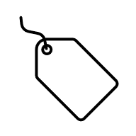
Our Approach: Anonymity Wrapper
?
Header:
Seq.Num
ID...
Header:
Seq.Num
ID...
Hi, Blake!
Enc
5f8ac9134d
5f8ac9134d
Dec
Hi, Blake!
?
Derive symmetric wrapper key
+ random label
Notes:
Idea is to wrap ciphertext and metadata of underlying messaging protocol to make the resulting ciphertext anonymous

Slide 7
Our Approach: Anonymity Wrapper
No anonymity under long-term key compromise
Strong anonymity under key compromise
Header:
Seq.Num
ID...
Header:
Seq.Num
ID...
Hi, Blake!
Enc
5f8ac9134d
5f8ac9134d
Dec
Hi, Blake!
Expensive public key crypto for each message
Only symmetric key crypto
Linear overhead in groups
Constant overhead in groups
Notes:
Matches sender keys:
Produces a constant-size ciphertext for the group
(have a chain of symmetric keys for the entire group, don’t need to encrypt for each member individually)

Slide 8






















Messaging 101
$$ck_{0}$$
$$ck_{0}$$
$$c_{1}$$
$$m_{1}=adec_{k_{1}}\left(c_{1}\right)$$
$$ck_{1} k_{1}$$
$$c_{1}=aenc_{k_{1}}{(m}_{1})$$
$$ck_{1} k_{1}$$
$$c_{2}$$
$$m_{2}=adec_{k_{2}}\left(c_{2}\right)$$
$$ck_{2} k_{2}$$
$$c_{2}=aenc_{k_{2}}{(m}_{2})$$
$$ck_{2} k_{2}$$
$$c_{3}$$
$$m_{3}=adec_{k_{3}}\left(c_{3}\right)$$
$$ck_{3} k_{3}$$
$$c_{3}=aenc_{k_{3}}{(m}_{3})$$
$$ck_{3} k_{3}$$
…
…
$$ck_{0}^{∗}$$
$$ck_{0}^{∗}$$
$ck_{1}^{∗}$ $k_{1}^{∗}$
$ck_{1}^{∗}$ $k_{1}^{∗}$

Slide 9





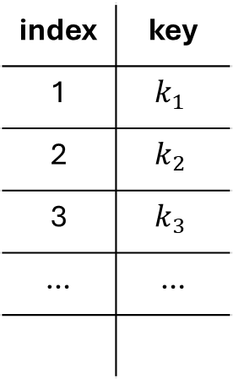







Metadata for Unreliable Networks
$$ck_{0}$$
$$ck_{0}$$
index | key
1 | $$k_{1}$$
2 | $$k_{2}$$
3 | $$k_{3}$$
… | …
$$ck_{1} k_{1}$$
$$c_{1}=aenc_{k_{1}}{(m}_{1})$$
$$c_{3}$$
+
index=3,
ID
$$ck_{1} k_{1}$$
$$ck_{2} k_{2}$$
$$c_{2}=aenc_{k_{2}}{(m}_{2})$$
$$ck_{2} k_{2}$$
$$ck_{3} k_{3}$$
$$c_{3}=aenc_{k_{3}}{(m}_{3})$$
$$ck_{3} k_{3}$$
…
…
$$ck_{0}^{∗}$$
$$ck_{0}^{∗}$$
$$m_{3}=adec_{k_{3}}\left(c_{3}\right)$$
$ck_{1}^{∗}$ $k_{1}^{∗}$
$ck_{1}^{∗}$ $k_{1}^{∗}$

Slide 10









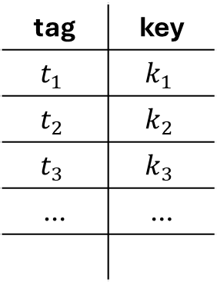

Anonymity Wrapper
$$ck_{0}$$
tag | key
$$t_{1}$$ | $$k_{1}$$
$$t_{2}$$ | $$k_{2}$$
$$t_{3}$$ | $$k_{3}$$
… | …
$$ck_{0}$$
$$c_{1}, t_{1}$$
$ck_{1} k_{1}$ $t_{1}$
$ck_{1} k_{1}$ $t_{1}$
$$ck_{2} k_{2} t_{2}$$
$$ck_{2} k_{2} t_{2}$$
metadata
$$c_{1}=aenc_{k_{1}}{(c}_{1}+ )$$
$$ck_{3} k_{3} t_{3}$$
$$ck_{3} k_{3} t_{3}$$
…
…
Potentially as direct encryption
$$ck_{0}^{∗}$$
$$c_{1}+ =adec_{k_{1}}\left(c_{1}\right)$$
$$ck_{0}^{∗}$$
metadata
…
…

Slide 11
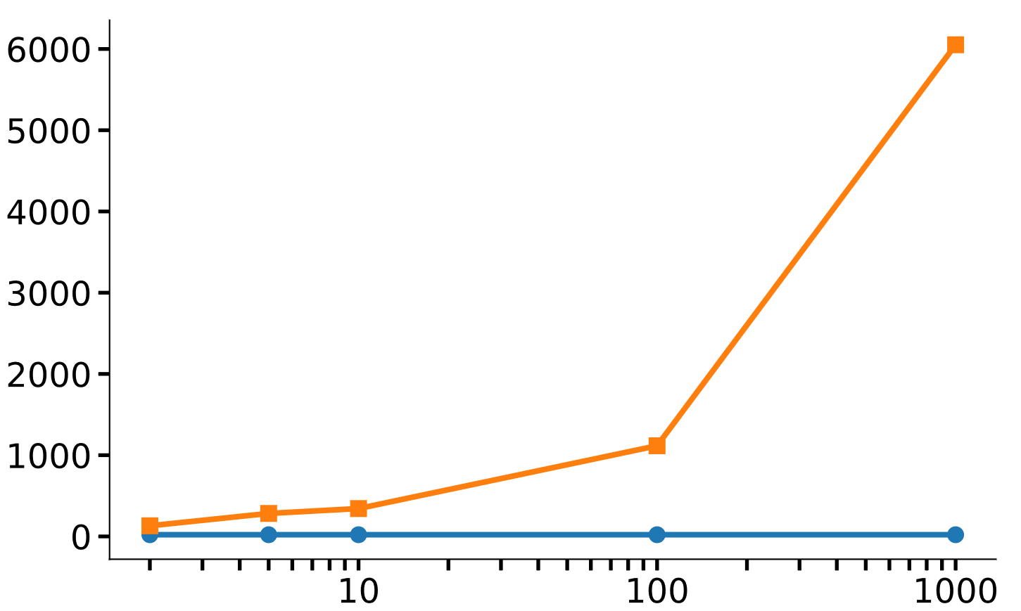
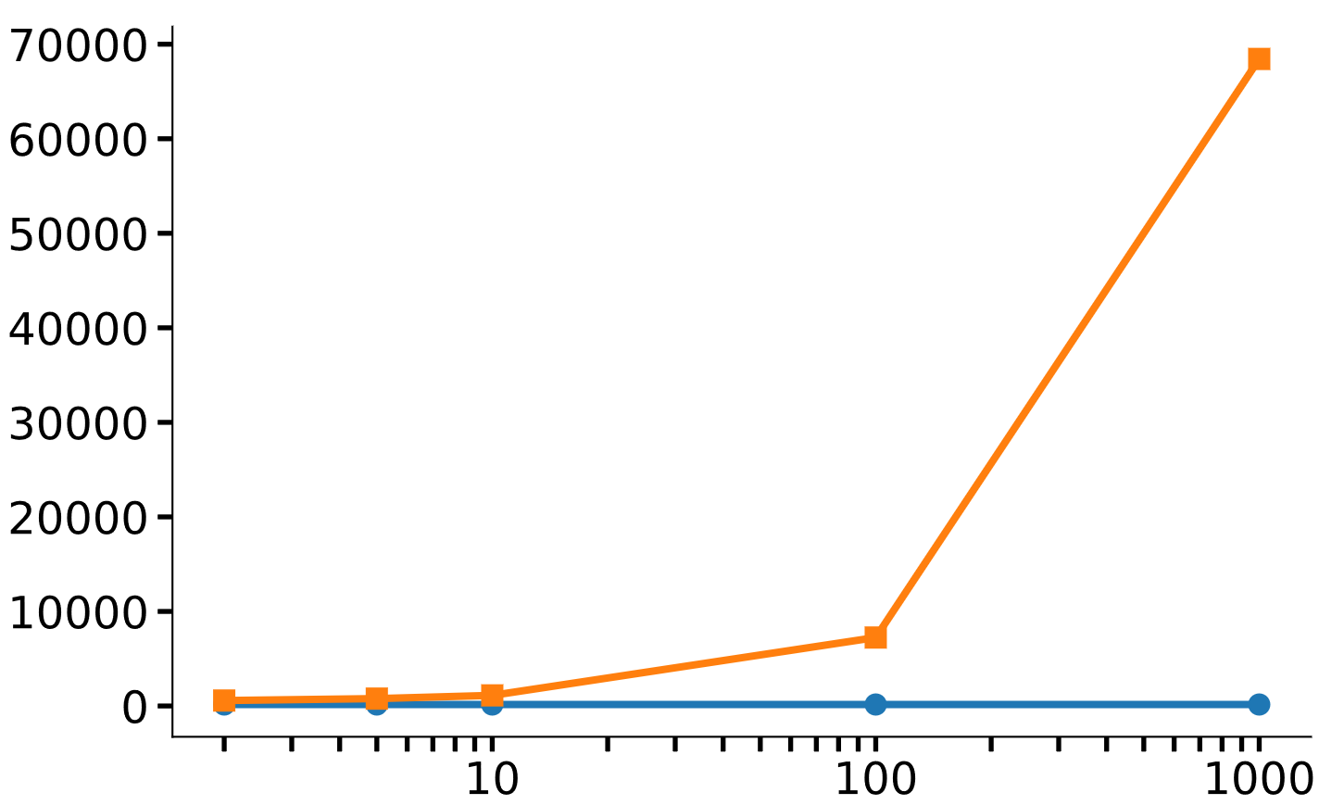
Anonymity Wrapper vs. Signal’s Approach
Encryption time (μs)
Ciphertext size (bytes)
6052μs
68 KB
131μs
576 B
Group size
Group size
21μs
155 B
Experiments performed on 32 core Intel® Core™ i9-14900K processor

Slide 12

Anonymity Wrapper vs. Signal’s Approach
Encryption time (μs)
Ciphertext size (bytes)
6052μs
68 KB
Sender state + 192 bytes
131μs
576 B
Receiver state
+ 600KB/contact
i.e., 600MB for 1000 contacts
Group size
Group size
21μs
155 B
Experiments performed on 32 core Intel® Core™ i9-14900K processor

Slide 13


Why the Large Receiver State?
$$ck_{0}$$
$c_{3}$, $t_{3}$
Notes:
Keep skipped key (must)
What if ahead key comes in?
Can trial derive
But this opens door for DoS
Thus: pre-compute tags
This is responsible for the large storage
Make this more efficient? Decide on incoming whether the ciphertext should be receivable

Slide 14
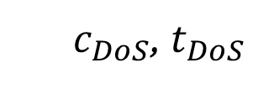





Why the Large Receiver State?
$$ck_{0}$$
trial derive keys?
$ck_{1} k_{1}$ $t_{1}$
$c_{3}$, $t_{3}$
$$ck_{2} k_{2} t_{2}$$
$$ck_{3} k_{3} t_{3}$$
$c_{DoS}$, $t_{DoS}$
For $t_{DoS}$need to iterate over all senders, expensive!
Notes:
For each potential sender a chain key
1000 users: 2 million key computations
Add visual to show there is one chain key per user
Keep skipped key (must)
What if ahead key comes in?
Can trial derive
But this opens door for DoS
Thus: pre-compute tags
This is responsible for the large storage
Make this more efficient? Decide on incoming whether the ciphertext should be receivable

Slide 15


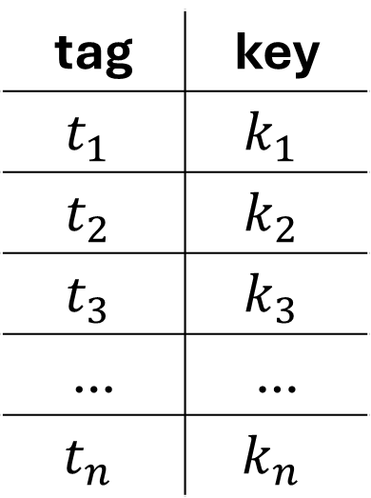


Why the Large Receiver State?
$$ck_{0}$$
tag | key
$$t_{1}$$ | $$k_{1}$$
$$t_{2}$$ | $$k_{2}$$
$$t_{3}$$ | $$k_{3}$$
… | …
$$t_{n}$$ | $$k_{n}$$
$ck_{1} k_{1}$ $t_{1}$
$c_{3}$, $t_{3}$
$$ck_{2} k_{2} t_{2}$$
Pre-computed lookup table for each sender!
$$ck_{3} k_{3} t_{3}$$
$c_{DoS}$, $t_{DoS}$
$$ck_{4} k_{4} t_{4}$$
$$ck_{5} k_{5} t_{5}$$
…
$$ck_{n} k_{n} t_{n}$$
$$n=2000$$
Notes:
For which user is the tag receivable is the question
If it is positive, know how to proceed

Slide 16
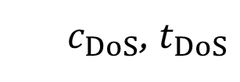

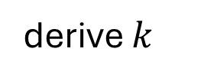
Fixing the Large Receiver State
+ 38KB/contact
3.8MB/1000 contacts
$$ck_{0}$$
tag | key
$$t_{1}$$ | $$k_{1}$$
$$t_{2}$$ | $$k_{2}$$
$$t_{3}$$ | $$k_{3}$$
… | …
$$t_{n}$$ | $$k_{n}$$
$ck_{1} k_{1}$ $t_{1}$
$$t$$
$c_{3}$, $t_{3}$
$$ck_{2} k_{2} t_{2}$$
is receivable?
Counting Bloom Filter
$$ck_{3} k_{3} t_{3}$$
yes
$c_{DoS}$, $t_{DoS}$
derive $k$
$$ck_{4} k_{4} t_{4}$$
False positives rare and cheap!
No false negatives!
$$ck_{5} k_{5} t_{5}$$
no
…
discard
$$ck_{n} k_{n} t_{n}$$
$$n=2000$$

Slide 17
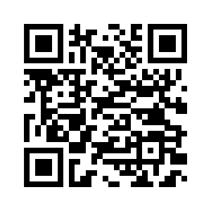











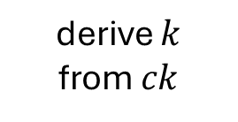



A Practical Wrapper Protocol for Metadata-Hiding in Messaging
Lea Thiemt, Paul Rösler, Alexander Bienstock, Rolfe Schmidt, Yevgeniy Dodis
Our group is looking for a Postdoc! ☺
Constant communication overhead
Strong guarantees on temp. state exposure
Signal considers deploying this protocol
$$ck_{0}$$
$$t$$
$$ck_{0}$$
$$c_{1},t_{1}$$
receivable?
$ck_{1} k_{1}$ $t_{1}$
Counting Bloom Filter
$ck_{1} k_{1}$ $t_{1}$
$$ck_{2} k_{2} t_{2}$$
metadata
$$ck_{2} k_{2} t_{2}$$
$$c_{1}=aenc_{k_{1}}{(c}_{1}+ )$$
no
yes
$$ck_{3} k_{3} t_{3}$$
$$ck_{3} k_{3} t_{3}$$
…
discard
derive $k$
from $ck$
…
$$ck_{0}^{∗}$$
eprint.iacr.org/2025/1619
$$ck_{0}^{∗}$$
$$c_{1}+ =adec_{k_{1}}\left(c_{1}\right)$$
…
metadata
…

